Slide 1
[ Name: Saunak Mukherjee] [Institution: DataTrained] [Flip Robo Technology]
Review and rating project

Slide 2
Problem Statement
We have a client who has a website where people write different reviews for technical products. Now they are adding a new feature to their website i.e. The reviewer will have to add stars(rating) as well with the review. The rating is out 5 stars and it only has 5 options available 1 star, 2 stars, 3 stars, 4 stars, 5 stars. Now they want to predict ratings for the reviews which were written in the past and they don’t have rating.

Slide 3
Web Scraping Details
Web Scraping done using selenium web driver.
Data for different product like smartphones, laptops, routers is scraped.
Data scraped from Flipkart.com
Around 20000 product reviews are scrap for this project.

Slide 4
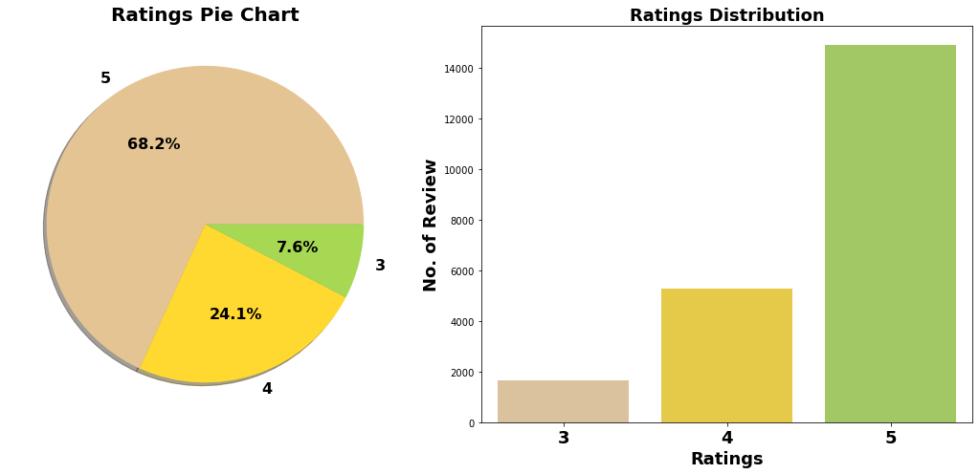
Exploration of Target Variable Ratings
1. Around 68.2% customer given 5- star rating followed by 24.11% customer given 4-star rating.
2. 7.6% customer given 3 star

Slide 5
Convert the text to lowercase
Remove the punctuations, digits and special characters
Tokenize the text, filter out the adjectives used in the review and create a new column in data frame
Remove the stop words
Stemming and Lemmatising

Slide 6
Machine Learning Model
The different classification algorithm used in this project to build ML model are as below:
Random Forest classifier
Logistics Regression
AdaBoost Classifier
Gradient Boosting Classifier

Slide 7
Evaluation Matrix
Random Forest Classifier gives maximum accuracy score.
Hyper parameter Tuning is perform over this best model.
{'criterion': 'gini', 'max_features': 'log2', 'n_estiators': 75}

Slide 8
Result
5-fold Cross validation that we performed over all model. Hyperparameter tuning is applied over Random Forest model and used it as final model.
Final Random Forest Classifier Model Accuracy Score : 0.7819847328244275 Confusion matrix of Random Forest Classifier : [[ 139 8 339] [ 6 559 1033] [ 14 28 4424]] Classification Report of Random Forest Classifier precision recall f1-score support 3 0.87 0.29 0.43 486 4 0.94 0.35 0.51 1598 5 0.76 0.99 0.86 4466 accuracy 0.78 6550 macro avg 0.86 0.54 0.60 6550 weighted avg 0.81 0.78 0.74 6550

Slide 9
5-fold Cross validation that we performed over all model. Hyperparameter tuning is applied over Random Forest model and used it as final model.

Slide 10
Algorithm | Precision | Recall | F1 Score | CV Score
Logistics Regression | 0.74 | 0.99 | 0.84 | 0.63
Decision Tree Classifier | 0.77 | 0.91 | 0.83 | 0.61
Ada Boost Classifier | 0.73 | 0.98 | 0.83 | 0.63
Gradient Boosting Classifier | 0.73 | 1.00 | 0.85 | 0.64
Final Model (RFC- Tuned) | 0.76 | 0.99 | 0.86

Slide 11
CONCLUSION
Successfully developed Machine learning model to predict product review ratings.
NLTK library used for text Mining.

